Slide 1

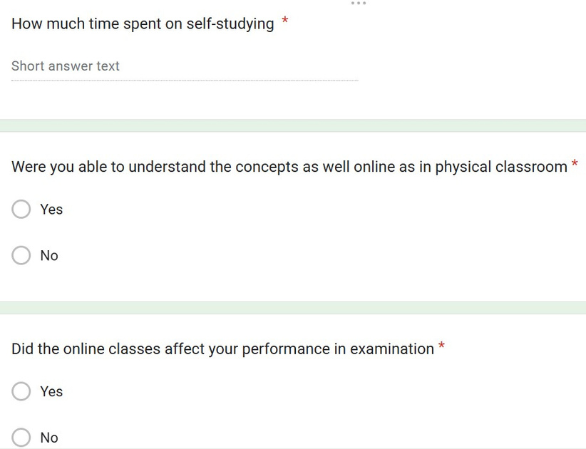
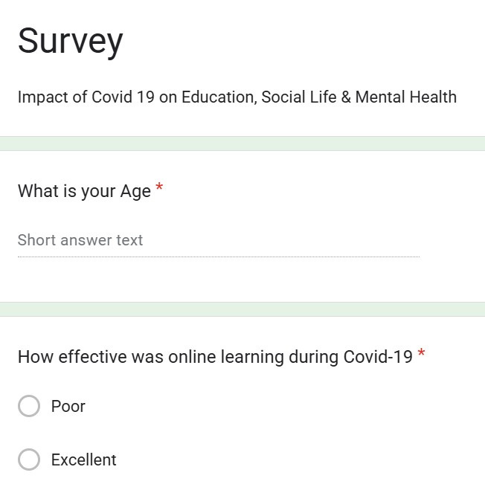
ImpaCT OF COVID 19 on Students

Slide 2

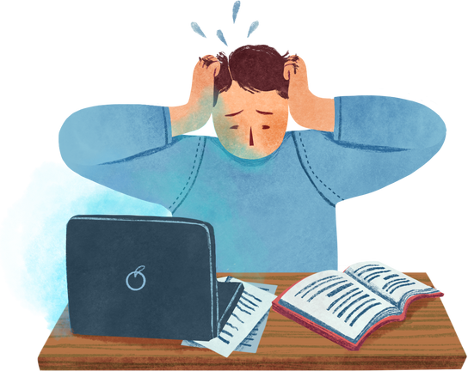


Very poor to average response
for education
Used Instagram, Facebook &
Whatsapp to socialize
To beat Stress tried
cooking, Gardening &
Writing
Poor Internet Connectivity
Spent time with the family
Missed eating out, Vacations and roaming around freely
Result affected
Missed Friends meet up

Slide 3

https://docs.google.com/forms/d/1ouIUieP6ZhIhKG2iPYRcsE-Vl3tgZKZy-wbI7W4nTtA/edit

